Slide 1

STORM SURGE
PREDICTION
GROUP-2
MEMBER - 1
NAMAN JADIYA
AI & ML (H) B3
500110793
MEMBER - 2
SHASHANK JAISWAL
AI & ML (H) B3
500109929

Slide 2

Coastal Flooding Overview
Scope
Coastal flooding, stemming from storms, poses significant hazards to coastal areas.
Increasing occupation of coastal regions exacerbates these hazards.
Coastal flooding results from storms, storm surges, sea level rise due to climate change, or tsunami waves.
Tropical Cyclones and Storm Surges
Tropical cyclones are comprised of precipitation and thunderstorms over warm tropical water.
Categorized based on wind speeds as tropical depressions, storms, or hurricanes.
Storm surges are irregular rises in sea level caused by cyclone winds, waves, and low atmospheric pressure.
Storm tide, the height of sea level during a storm surge, can amplify flooding when coinciding with high tide.
Impacts and Mitigation
Coastal flooding is predicted to increase, necessitating investment in adaptation measures.
The Coastal Property Model estimates flood damages, future adaptation costs, and avoided damage costs.

Slide 3

Coastal Property Model
Objectives
Develop methods to simulate adaptation decisions for predicting and testing safety measures.
The Coastal Property Model estimates flood damages for various scenarios, including sea level rise and storm surges.
Provides insights into future adaptation costs and the economic benefits of mitigation efforts.
Key Features
Estimates flood damage and future adaptation costs at an aggregate level.
Enables decision-makers to assess the effectiveness of different adaptation strategies.
Aids in understanding the economic implications of coastal flooding and the benefits of investing in mitigation.

Slide 4
BACKGROUND Sea level rise Global mean sea level change primarily driven by land-ice changes and thermal expansion. Local sea level changes influenced by gravitational effects, changes in ocean heat and salinity, dynamic sea levels, and non-climatic processes.
CAUSES
Global mean sea level (GMSL) change is driven primarily by land-ice changes and thermal expansion, with a minor contribution from changes in global land-water storage. Local, relative sea level changes are additionally affected by
gravitational, rotational, and deformational effects of redistribution of mass between land-ice and the ocean, as well as between land water reservoirs and the ocean.
changes in the distribution of heat and salinity in the ocean (i.e., steric effects).
Changes in winds and currents (i.e., dynamic sea levels).
Non-climatic processes such as glacial-isostatic adjustment, tectonics, and sediment compaction
Extreme High Water Levels
Coastal flooding driven by stochastic high water events like storm surges, waves, and astronomical high tides. Interaction of long-term sea level rise with shorter-duration events impacts frequency and magnitude of high water levels. Factors influencing tropical cyclone frequency and intensity include easterly waves, wind shear, temperature gradients, moisture, and atmospheric particulates.
easterly waves.
vertical wind shear.
vertical atmospheric temperature gradients.
atmospheric moisture.
atmospheric particulates such as aerosols, black carbon, and dust.
localized anomalies of sea surface and upper ocean temperatures

Slide 5
Study Approach and Model Overview
Study Approach
National-scale analysis performed to reflect traditional risk-based cost-benefit analysis.
Formulated alternative approaches to estimate the impact of decisions beyond maximizing net benefits.
Alternative approaches consider observed underinvestment in flood protection and evaluate sub-optimal decisions' impact on aggregate economic costs.
Model Overview
The model simulates national-scale flood risk and adaptation decisions.
Accounts for various adaptation strategies such as protective structures, beach nourishment, and property abandonment.
Enables evaluation of how different decision-making approaches impact societal costs from sea level rise and storm surge flooding.

Slide 6

Historical Context and Contemporary Trends
Key Points:
Storm surges, historically devastating, cause widespread destruction and loss of life.
Notable events include the 1970 Bhola cyclone, Cyclone Nargis in 2008, Typhoon Haiyan in 2013, Hurricane Katrina in 2005, and Hurricane Sandy in 2012.
Population density along coasts has significantly increased, exacerbating vulnerability.
Over half of the nation's economic productivity is located within coastal zones, with critical infrastructure susceptible to storm surges.
Additional Info:
Urgent need for effective storm surge preparedness, mitigation, and resilience measures globally.
Proactive planning and investment in infrastructure and community resilience essential for reducing storm surge risk.

Slide 7

The SLOSH Model The Sea, Lake and Overland Surges from Hurricanes (SLOSH) model, developed by the National Weather Service (NWS), estimates storm surge heights. Incorporates atmospheric pressure, size, forward speed, and track data to simulate wind fields driving storm surges. Crucial for emergency management, aiding in evacuation planning, infrastructure design, and disaster response.
Model Components:
Utilizes physics equations applied to specific shorelines, considering bay and river configurations, water depths, and physical features.
Offers deterministic, probabilistic, and composite modeling approaches to predict storm surge.
Operational Efficiency and Limitations:
Computationally efficient for operational use, accurately resolves flow through barriers and coastal reflections.
Limitations include lack of wave impact modeling and normal river flow consideration, ongoing advancements aim to enhance predictive capabilities.
Geographic Coverage and Future Outlook:
Applied extensively along U.S. coastlines and regions like Hawaii, Guam, Puerto Rico, and the U.S. Virgin Islands.
Continued advancements aim to enhance coastal resilience and minimize hurricane and storm surge impacts.

Slide 8
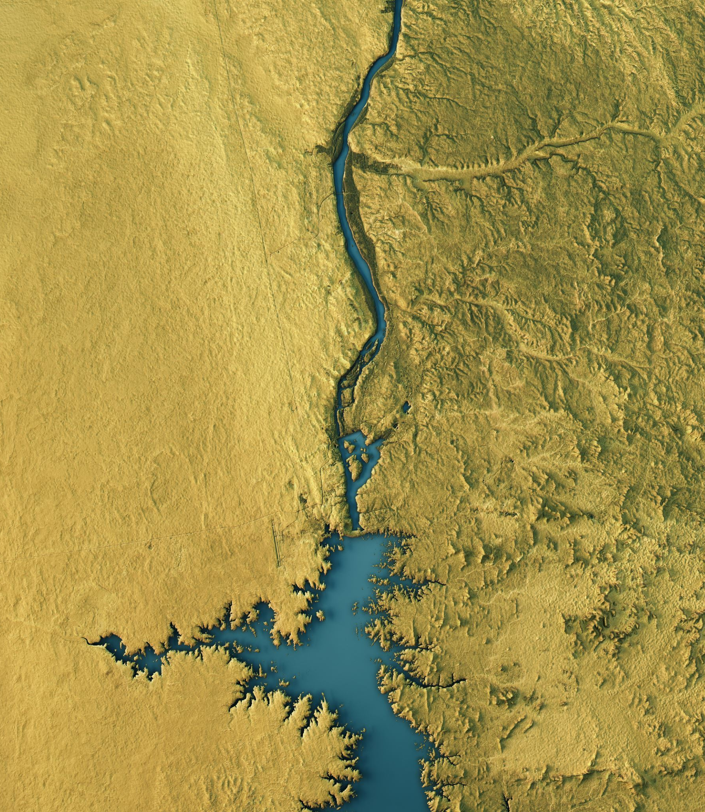
The NCPM Model The National Coastal Population Model (NCPM) assesses flood risk and guides adaptation strategies in US coastal regions. Recent enhancements aim to align the model with traditional risk-based, cost-benefit analysis and address underinvestment in flood protection.
Original NCPM Framework:
Divides vulnerable coastal areas into a 150-meter grid, estimating flood hazard, property value exposure, and Expected Annual Damages (EAD) for each cell.
Simulates damages and adaptation decisions over the 21st century, considering sea level rise and storm surge events.
Adaptation Options and Limitations:
Offers four adaptation options: beach nourishment, armoring, structure elevation, and abandonment.
Original limitations included prioritizing abandonment regardless of cost-effectiveness and evaluating options based solely on cost comparisons.
Improvements to NCPM:
Modified adaptation option order prioritizes cost-effective measures before abandonment.
Introduced a cost-benefit approach comparing the cost of each option to expected reduction in damages, ensuring decisions maximize cost-effective risk reduction.
Cost-Benefit Analysis in NCPM:
Incorporates a test comparing estimated discounted avoided damages to adaptation costs.
Armoring and elevation triggered to protect against the 100-year flood, with benefits equivalent to damages up to and including the 100-year flood.
Simulation and Results:
Tracks adaptation investments and residual flood damage over a 100-year simulation period.
Provides insights into total investment, property abandonment costs, and residual flooding costs, aiding in informed decision-making.

Slide 9
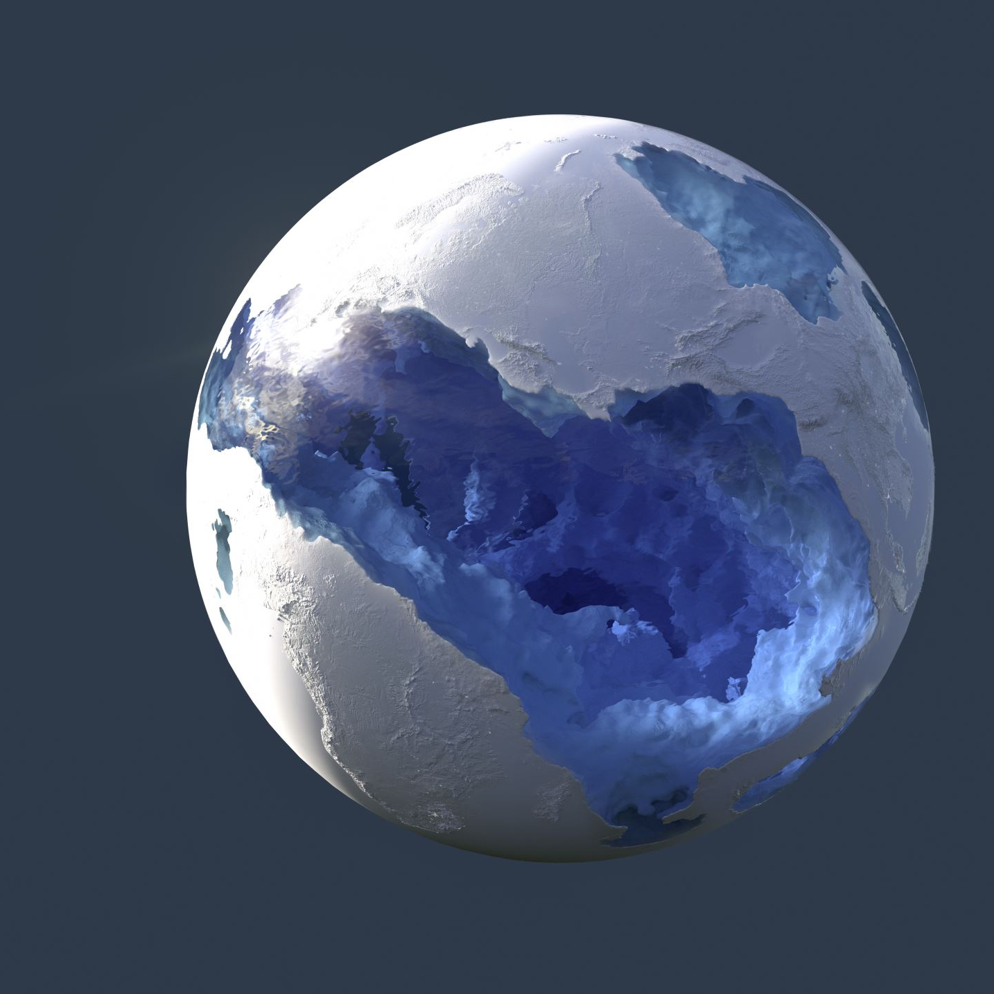
The ADCIRC Model The Advanced Circulation (ADCIRC) model is a robust numerical ocean circulation model used for simulating storm surge, tides, and coastal circulation problems. Developed by Drs. Rick Luettich and Joannes Westerink, ADCIRC is maintained through collaboration among academic, governmental, and corporate entities.
Model Framework and Capabilities:
Operates as a system of computer programs solving time-dependent, free-surface circulation and transport problems in 2D and 3D.
Built on the shallow water equations, employing the finite element method on unstructured grids for flexibility in coastal geometries.
Model Applications:
Predicts storm surge heights and flooding extent, aiding disaster preparedness and response.
Simulates tidal patterns, wind-driven circulation, and larval transport for ecological research and marine resource management.
Supports nearshore marine operations and dredging feasibility studies crucial for coastal engineering projects.
Model Features and Optimization:
Optimized for parallel computing, enabling rapid computation on supercomputers.
Offers multiple bottom friction formulations and coupling capabilities with other models for enhanced predictive accuracy.
Incorporates advanced features for handling complex coastal dynamics.
ADCIRC Prediction System™ (APS™):
Leverages ADCIRC's capabilities to provide timely, high-resolution information on coastal storm surge, flooding, and winds.
Critical for disaster management, historical storm analysis, risk assessment, planning scenarios, and real-time forecasting.
Results available on the Coastal Emergency Risks Assessment (CERA) website for informed decision-making at all levels.

Slide 10

Case Study:
A specific case study focusing on forecasting water levels in the Pearl River Estuary in China highlights the application of CNNs in surge prediction. This study utilizes a large dataset derived from numerical simulations to train the CNN model and achieve accurate surge forecasts at multiple stations within the estuary.
The integration of ML techniques, particularly ANN and CNN architectures, has significantly advanced storm surge forecasting. These algorithms offer the potential to overcome traditional model limitations and provide accurate predictions by leveraging large datasets and extracting meaningful features from input variables. Hybrid approaches that combine ML techniques with physics-based models further enhance predictive accuracy, offering a promising solution for reliable storm surge forecasting in coastal regions. However, ongoing research is needed to address challenges and improve the effectiveness of ML methodologies in storm surge prediction.

Slide 11
Uncertainty Analysis in Storm Surge Estimation Estimating storm surge hazard faces challenges due to limited data availability, leading to the development of sophisticated methods relying on statistical characterization of tropical cyclone (TC) forcing.
Classification of Uncertainty:
Aleatory uncertainty: natural randomness of a process.
Epistemic uncertainty: lack of knowledge about model validity.
Addressed through error term inclusion and logic tree approaches.
Treatment of Uncertainty
Follows probabilistic seismic hazard analysis (PSHA) approach.
Aleatory uncertainty from model differences, epistemic reduced through alternative data and methods.
Development of Synthetic Hurricane Tracks:
Numerical models translate stochastically generated hurricane forcing into surge and wave estimates, addressing uncertainties associated with model parameters.
Model Parameter Sensitivity Analysis:
Conducted to understand parameter impact on storm surge estimation.
Significant parameters identified to improve model accuracy.

Slide 12
Climate Change Impact on Uncertainty:
Introduces additional uncertainties due to changes in atmospheric variables and TC characteristics.
Highlighting the need for improved modeling techniques and uncertainty analysis.
Factors Affecting Surge and Wave Height:
TC characteristics, coastline shape, ocean bathymetry, and local features influence surge and wave height.
Limited research in certain regions underscores the importance of addressing uncertainties in forecasting.
Recommendations and Conclusion:
Utilize ensemble methods and statistical approaches to improve storm surge estimation.
Finer model resolution and large ensemble sets suggested for accurate future projections.
Future Directions:
Focus on refining numerical modeling techniques, improving data availability, and enhancing understanding of TC-climate change interactions for more robust storm surge prediction and mitigation.

Slide 13

Model Integration for Storm Surge Estimation
Understand Coastal Dynamics: Analyze factors like atmospheric conditions, ocean dynamics, and human interventions influencing storm surge and flooding.
Historical Insights: Study past storm surge events to guide parameter selection and model development, considering intensity, frequency, and spatial distribution.
Current Methods: Examine existing models like SLOSH and NCPM for their principles and limitations, serving as benchmarks for new approaches.
Machine Learning Exploration: Utilize ML techniques such as neural networks to capture complex relationships between input variables and storm surge outcomes.
Uncertainty Analysis: Assess reliability using uncertainty analysis methods like sensitivity analysis and Monte Carlo simulations to identify sources of uncertainty.
Integration Process: Gather and preprocess data, select appropriate models, train and validate them, integrate predictions, evaluate performance, and continually refine the model for accurate storm surge estimation.

Slide 14
Future Directions in Storm Surge Estimation
Updating Geographical and Topological Changes:
Dynamic integration of bathymetric data based on recent surveys and real-time monitoring.
Adaptive mesh refinement techniques to adjust grid resolution in response to coastal changes.
Incorporation of updated coastal infrastructure datasets to reflect recent modifications.
Integration of Climate Change Scenarios:
Inclusion of future sea level rise projections and erosion rates into surge models.
Development of scenario-based simulations to assess combined impacts of climate change and storm surge.
Enhanced Data Assimilation Techniques:
Exploration of advanced methods to assimilate real-time observations and satellite data.
Integration of satellite-derived information on land cover changes and shoreline evolution.
Continuous Model Evaluation:
Regular validation against observed events and benchmarking exercises.
Collaboration with research institutions and government agencies for comprehensive validation studies.

Slide 15

Technological Advancements in Storm Surge Estimation
High-Resolution Remote Sensing Data:
Utilization of satellite imagery and LiDAR for accurate coastal topography.
Integration of emerging technologies like hyperspectral imaging and UAVs.
Machine Learning and AI:
Optimization of model parameterization and data assimilation processes.
Automated feature detection and classification using AI-driven systems.
Big Data Analytics and Cloud Computing:
Utilization of cloud infrastructure for handling large volumes of data.
Deployment of parallel processing techniques for real-time forecasting.
IoT and Sensor Networks:
Deployment of coastal monitoring networks for real-time data collection.
Integration of sensor data streams for continuous model calibration.
GIS and Spatial Analysis:
Advancement of GIS technologies for spatial data visualization.
Development of interactive platforms for decision support.
VR and AR Applications:
Immersive visualization of storm surge scenarios for stakeholder engagement.
Development of interactive tools for public education and participatory planning.
By embracing these advancements, storm surge estimation models can become more accurate, reliable, and user-friendly, contributing to effective disaster preparedness and resilience-building efforts in coastal regions

Slide 16

Model Validation and Tools
Validation Process:
Validate models using k-fold cross-validation with k = 10.
Assess performance using Pearson’s correlation coefficient, Nash-Sutcliffe efficiency, RMSE, and modified Mielke index.
Test sensitivity to tide gauge data availability by shortening records for validation.
Tools and Methods Utilized:
Random Forest Algorithm: Utilized for ensemble learning and prediction averaging.
Bootstrap Aggregating (Bagging): Employed for generating bootstrap samples .
Decision Trees: Used in Random Forest for modeling feature relationships.
Ensemble Learning: Aggregated predictions from multiple models for improved performance.
Feature Importance Analysis: Determined the significance of input features for surge prediction.
Hyperparameter Tuning: Optimized model parameters to enhance performance.
Probabilistic Modeling: Utilized Bayesian inference or Monte Carlo simulations for uncertainty analysis.
Validation and Calibration: Assessed and adjusted model accuracy and reliability.
Forecasting: Predicted future storm surge events based on real-time or forecasted data.

Slide 17
Algorithm for Probabilistic Storm Surge Prediction
All possible Input Features:
Uncertainty
Temperature Effects
Wind Setup
Storm Surge Propagation
Ocean Circulation
Tidal Interaction
Gravitational Effect
Rotational Effects
Vertical Wind Shear
Atmospheric Moisture
Localized Anomalies of Sea Surface and Upper Ocean Temperatures
Vertical Atmospheric Temperature Gradients
Easterly Waves
Deformational Effects
Coastal Currents
Atmospheric Particulates such as Aerosols, Black Carbon, and Dust
Salinity Effects
Glacial-Isostatic Adjustment (GIA)
Tectonics
Expected Output:
A probabilistic predicting model aiming to provide a probability distribution of potential storm surge outcomes.

Slide 18
Modeling Approach:
Utilize the 19 input factors as weighted variables.
Employ probabilistic techniques like Bayesian inference or Monte Carlo simulations.
Generate a probability distribution of potential storm surge magnitudes.
Uncertainty Analysis:
Incorporate uncertainty estimates for each factor and their interactions.
Conduct sensitivity analysis to assess the impact of uncertainties on predicted outcomes.
Validation and Calibration:
Validate the model against observed storm surge data.
Adjust model parameters or input data based on observed outcomes to enhance performance.
Forecasting:
Use the validated model for probabilistic forecasting of future storm surge events.
Input real-time or forecasted data on the 19 factors to generate probabilistic predictions.
Assist decision-makers in assessing and preparing for potential coastal inundation risks.

Slide 19
Procedure
Data Sampling (Bootstrap Aggregating or Bagging):
Start with a training dataset containing n samples and m features.
Create bootstrap samples (random samples with replacement) of the training data for each tree, typically two-thirds of the original data.
Leave out one-third of the data (out-of-bag samples) for testing model performance.
Tree Construction:
Grow decision trees for each bootstrap sample recursively.
At each node, consider a random subset of k features for splitting, usually the square root of the total number of features.
Split nodes based on criteria like Gini impurity for classification or mean squared error for regression, until stopping criteria are met.
Ensemble Learning:
Make predictions for each tree using out-of-bag samples or a validation dataset.
Aggregate predictions across all trees to obtain final ensemble predictions.
Feature Importance:
Measure feature importance based on how much each feature decreases impurity or mean squared error across all trees.
Tuning Parameters:
Tune hyperparameters like the number of trees, maximum tree depth, minimum samples per split, and number of features considered.
Prediction:
Use the trained and tuned model to make predictions on new data by passing it through each tree and aggregating the results.

Slide 20

RESULT AND CONCLUSION
Results
The coastal storm surge model, integrating multiple linear regression and Random Forest algorithm, accurately predicted surge magnitudes by considering complex factors like atmospheric conditions and ocean dynamics. Employing remote sensing and atmospheric reanalysis datasets, the model demonstrated robustness across diverse environmental contexts. Uncertainty analysis enhanced reliability, validated through rigorous cross-validation.
Conclusion
The model represents a significant advancement in predicting coastal inundation, aiding disaster preparedness and resilience. Future research should refine the model's spatial and temporal resolution, expand data inputs, and leverage emerging technologies for real-time forecasting. Overall, it stands as a crucial tool in mitigating risks posed by extreme weather and climate change.

Slide 21


